Slide 1
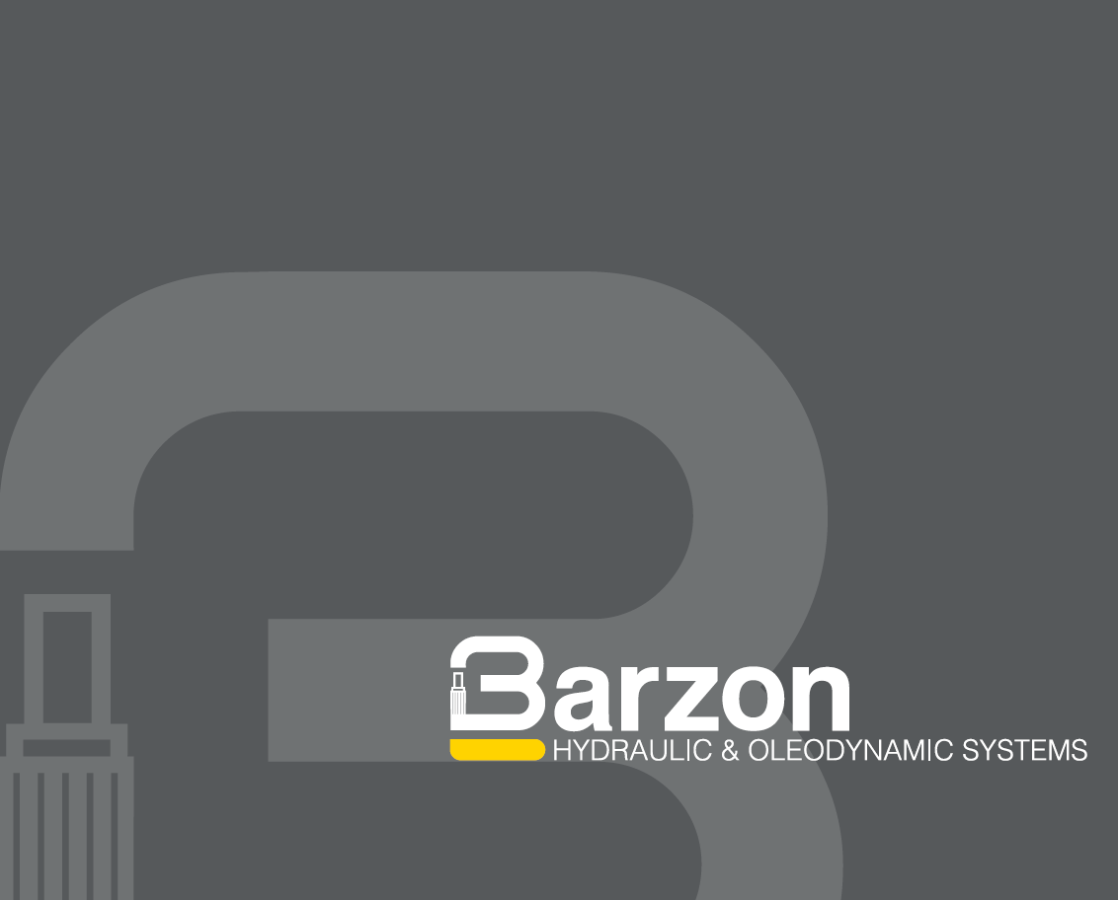
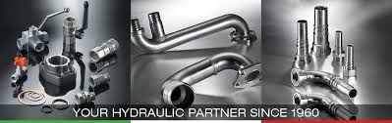

«MADE IN ITALY»
Quality and Innovation Since 1960
OUR:
KNOW
HOW
IS:
YOUR
SAFETY
SOMMA LOMBARDO, DECEMBER 9, 2019

Slide 2
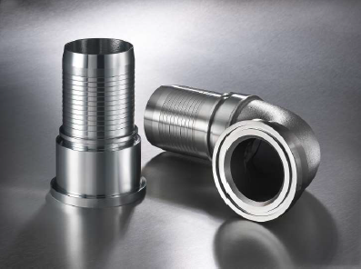
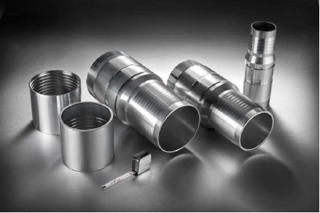
MISSION
F.lli Barzon srl, leading manufacturing company established in 1960, is today a pacesetter in manufacturing top quality and reliable precision turned parts.
Our mission is to Innovate and develop new and challenging applications, increasing customers target and improving company core competency in top related field of competence.

Slide 3
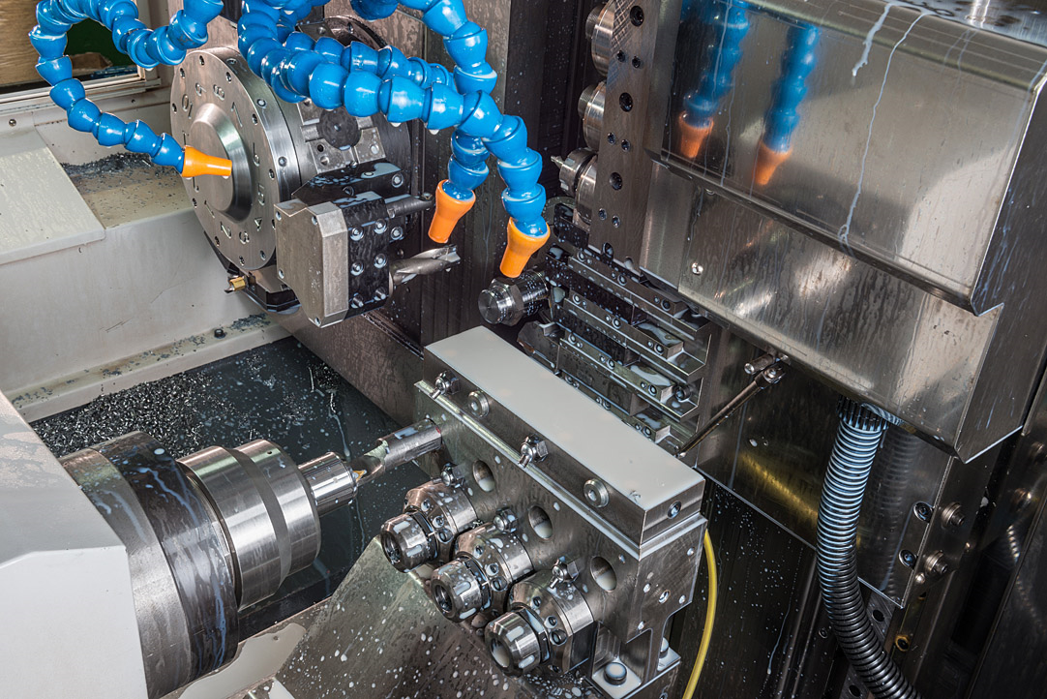
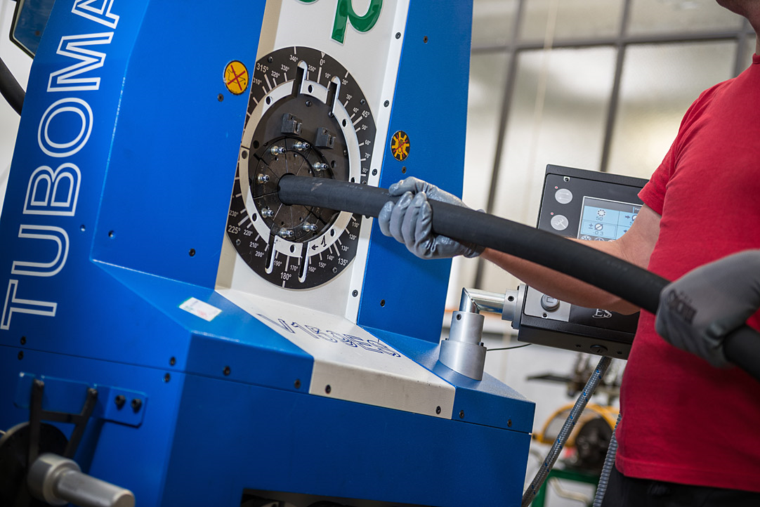
HYDRAULICS DEPARMENTS
MECHANICAL TURNING
HOSE ASSEMBLY

Slide 4
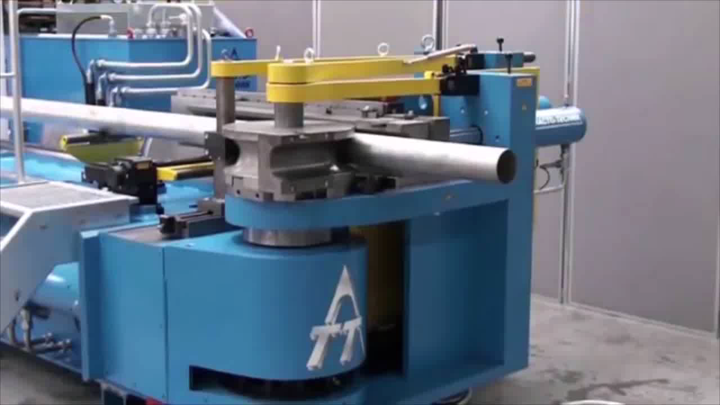
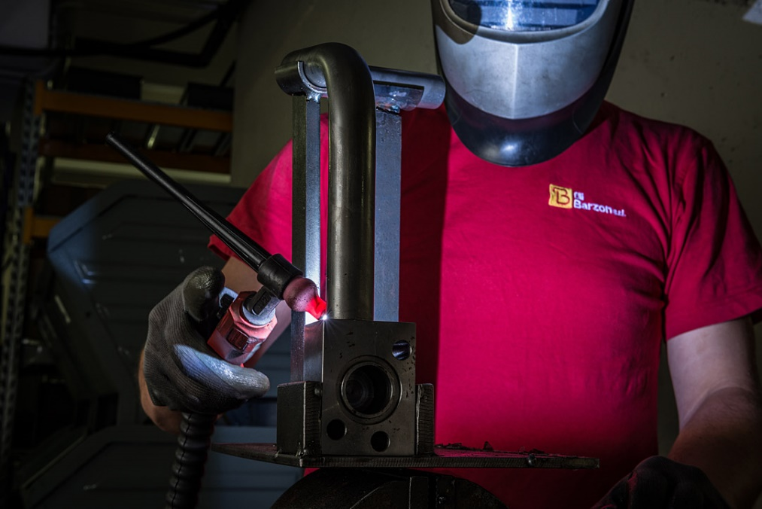
INDUSTRIAL DEPARMENTS
PIPE BENDING
SOLDERING

Slide 5
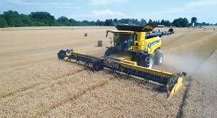
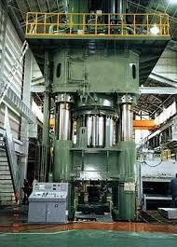
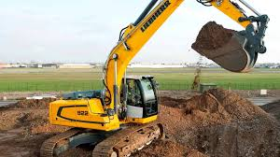
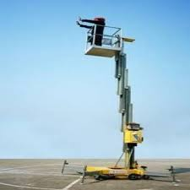
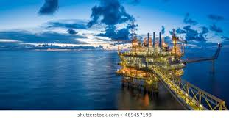
MARKET
Main application areas of Fratelli Barzon Hydraulics products are:
• Original Equipment Manufacturer – Spare parts
• Earthmoving and lifting machinery
• Steelworks, Quarrying and Mining
• Agriculture and Forestry
• Energy Sector, Oil and Gas

Slide 6
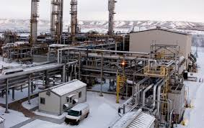
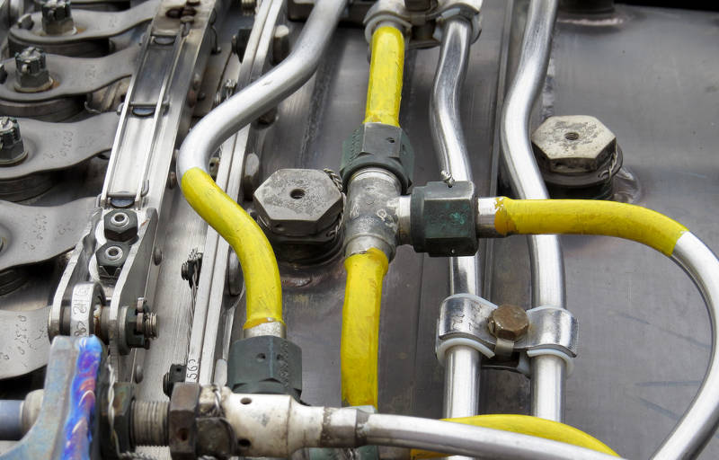
MARKET
Main application areas of Fratelli Barzon Industrial products are:
Water Suction, compressed air
Hot water
Welding hoses
Anti-fire application
Aircraft Fuel Hose
Mining Hose, Steel Mills
Material handling (anti-abrasive tubes )
Chemical Hoses
Petroleum Dispensing Hose
Mineral Oils, Fuels, Gas extraction
Marine Hoses
Steam Hose
OffShore : Mud, Bulk materials , oil.

Slide 7
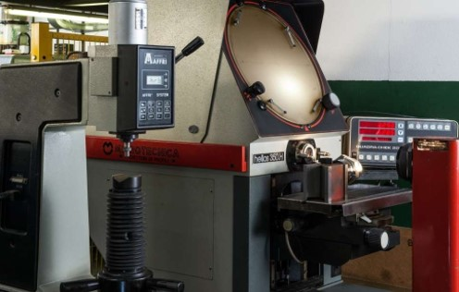
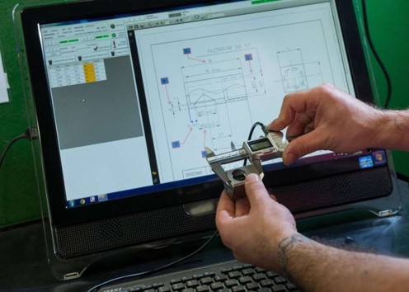
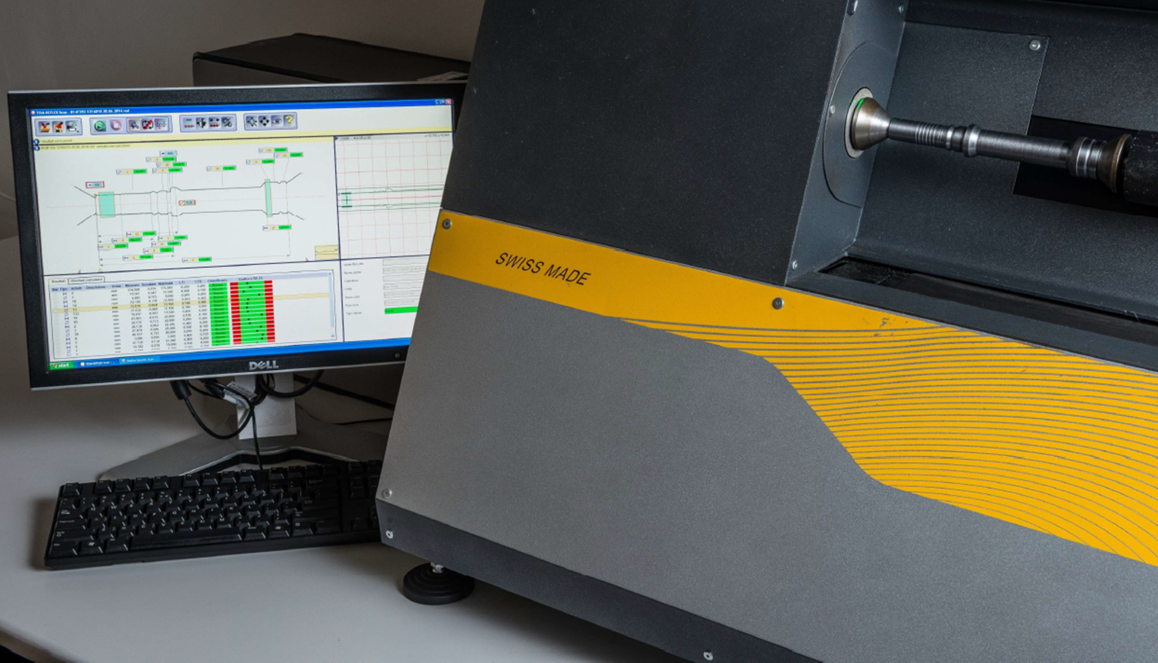


QUALITY
F.lli Barzon improve a strict quality inspection system all over production process by advanced measurement technology:
Measuring laser system
CMM machine
Pulse bench
Hardness test machine.

Slide 8
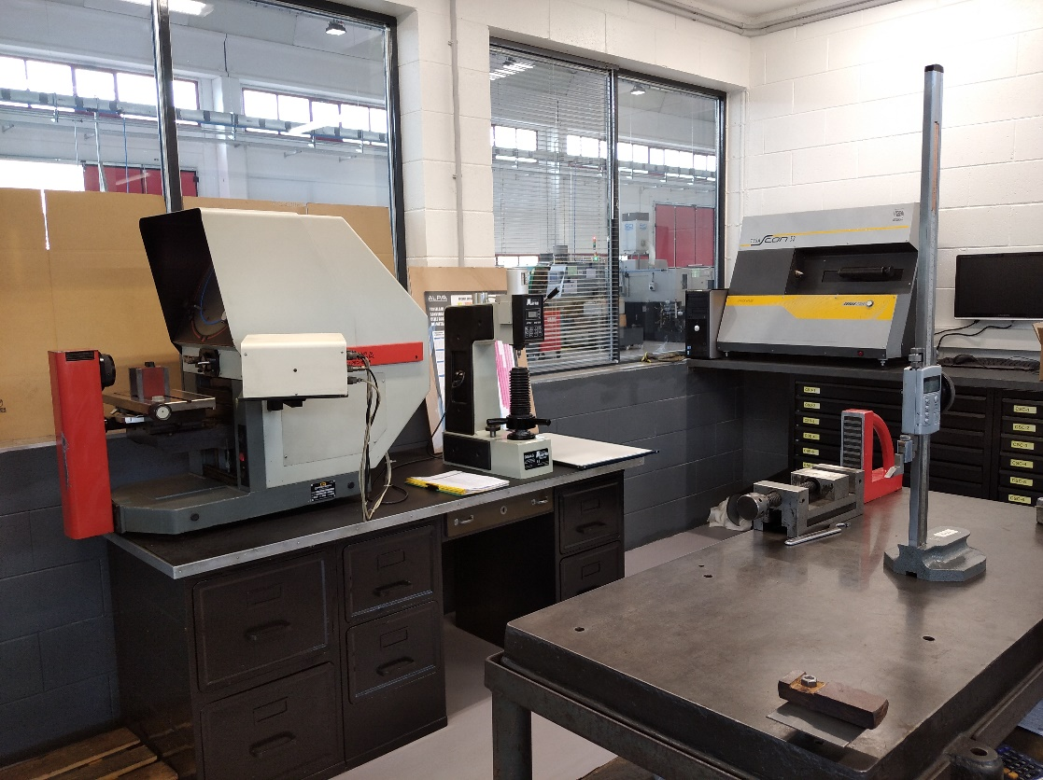
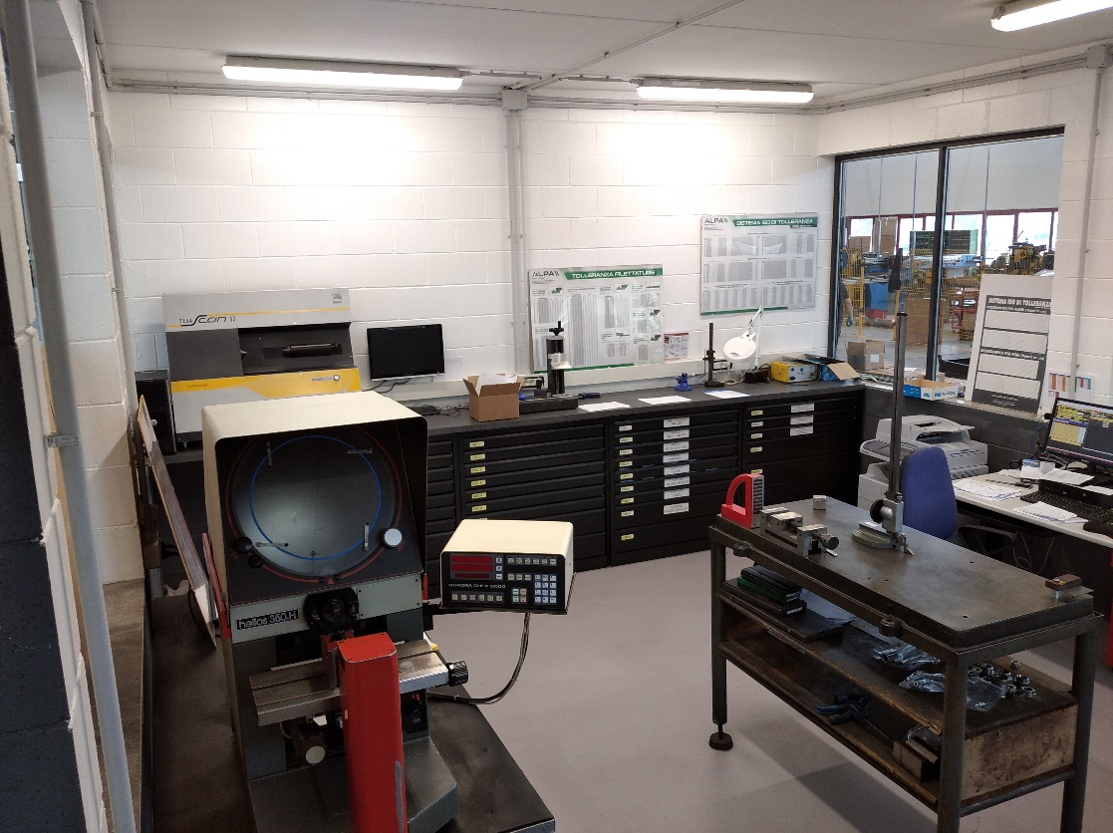
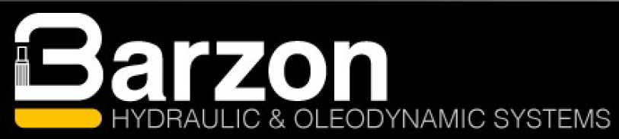

Slide 9
WE ARE PROUD TO CARE
Quality work is never an accident...

Slide 10
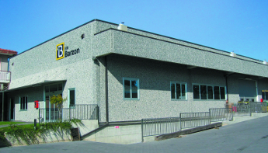
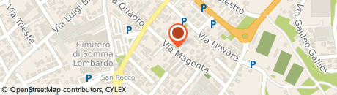
FIGURES
Turnover 2019 € 5.020.000 ( +7,5% vs 2018)
Turnover 2018 € 4.670.000 (+15% vs 2017)
Employee: 25
2019: new facilities (3000m² in addition to actual plant), Total 4500m²
15 Turning machines, 5 Bending machines, 6 crimping machines, 1 furnace for brazing

Slide 11
MACHINERY PARK
3 automatic mono-spindle lathes
8 CNC
2 multi-spindle lathes
5 crimping machines
3 bending machines
2 CNC bending machines
1 furnace for brazing and annealing
1 walterscheid end forming machine
2 CNC B56 2SM bars 70
1 sliding headstock lathe Hanwha STL 38H
2 sliding headstock lathe Hanwha XD26H

Slide 12
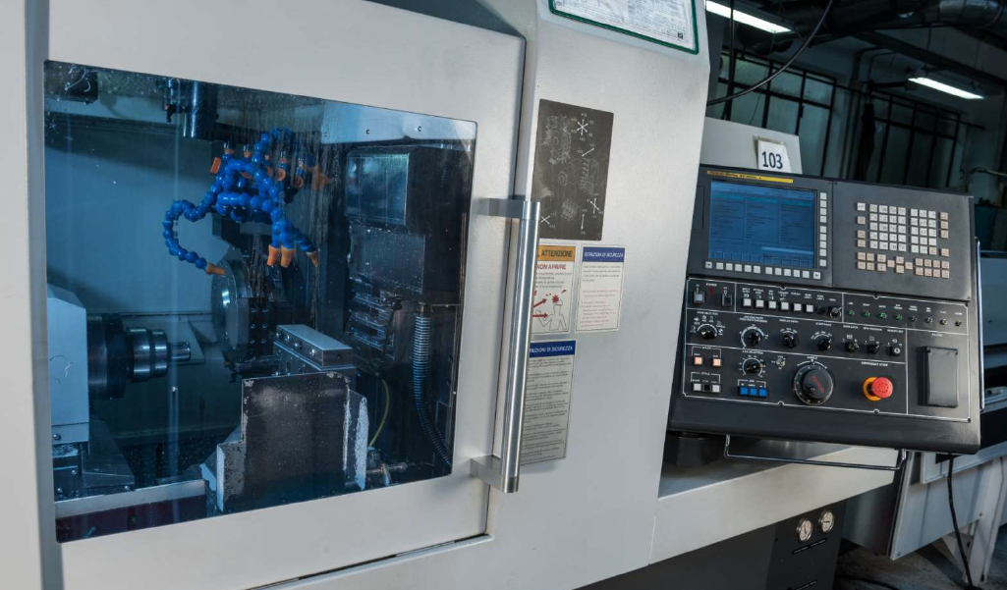

Slide 13
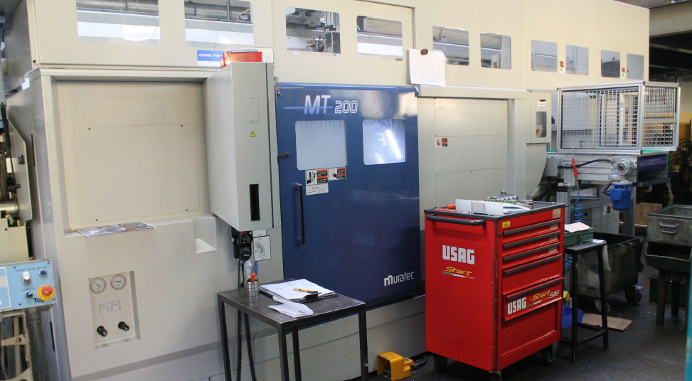

Slide 14
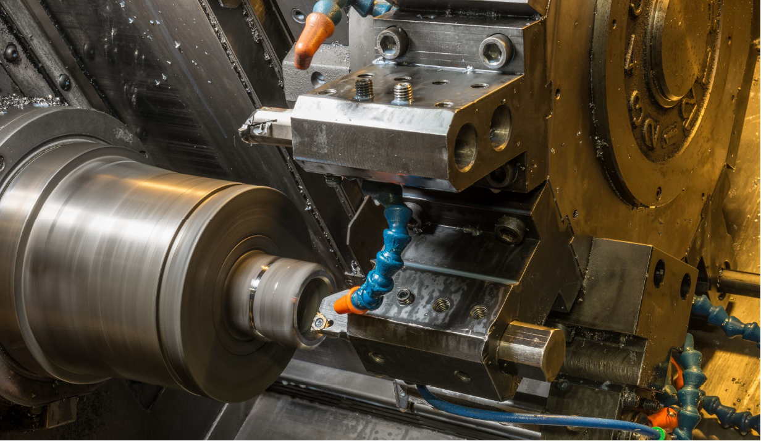

Slide 15
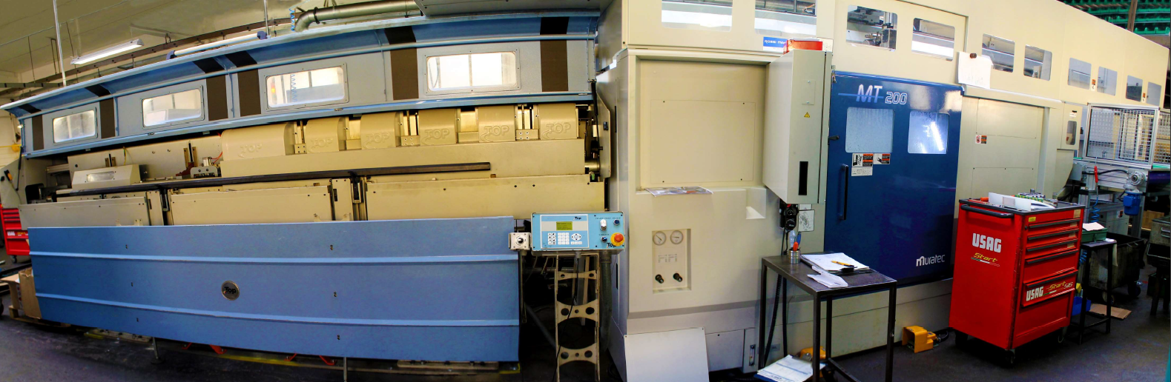

Slide 16
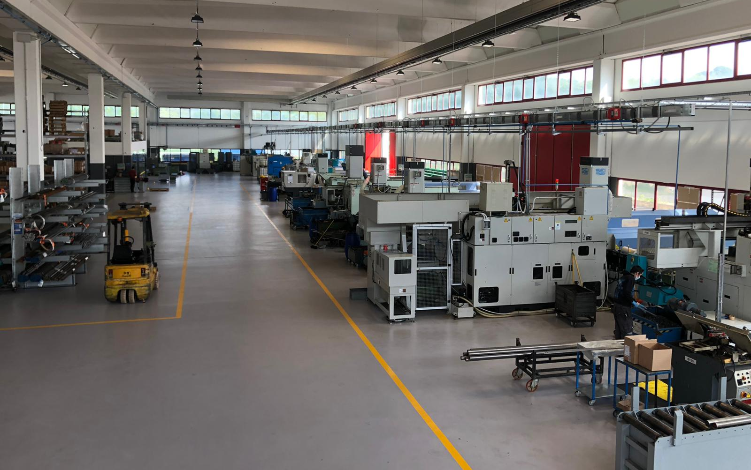

Slide 17
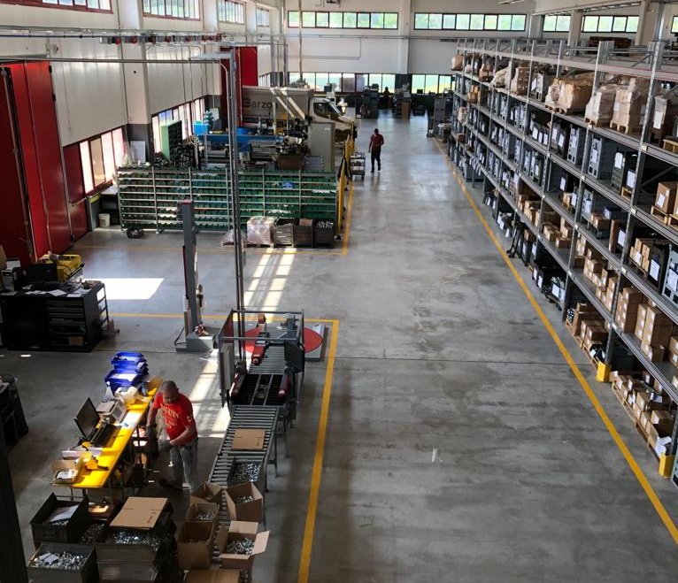

Slide 18
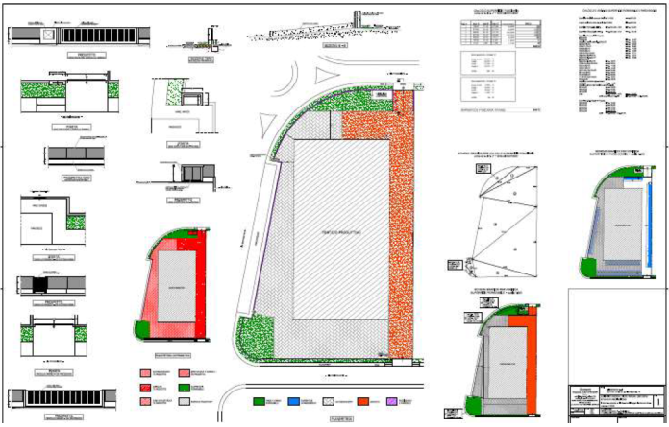
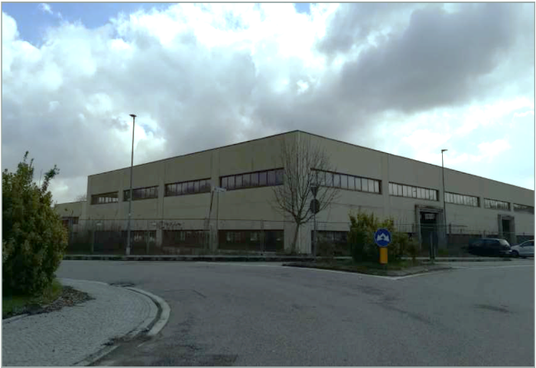
2018-2019 INVESTMENT
2019: new facility Total 4500m²
Planned:
  2 multi spindle
  1 CNC (6 axis)
  1 CNC vertical Lathe (Big diameters fittings)
High flexibility and autonomy in machining operations

Slide 19
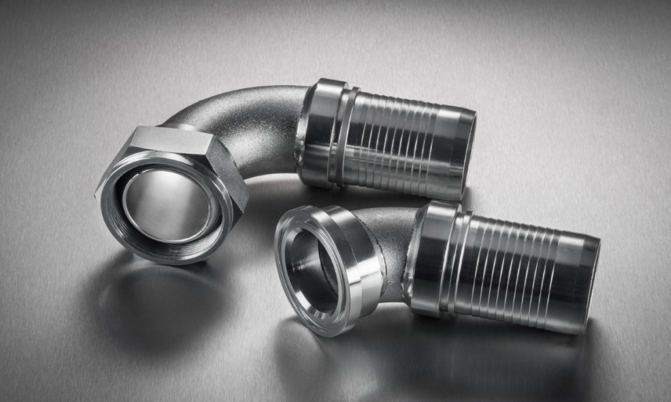
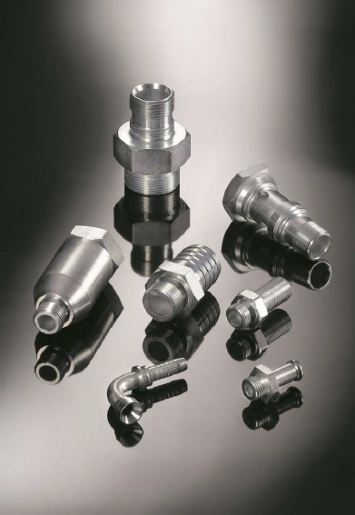
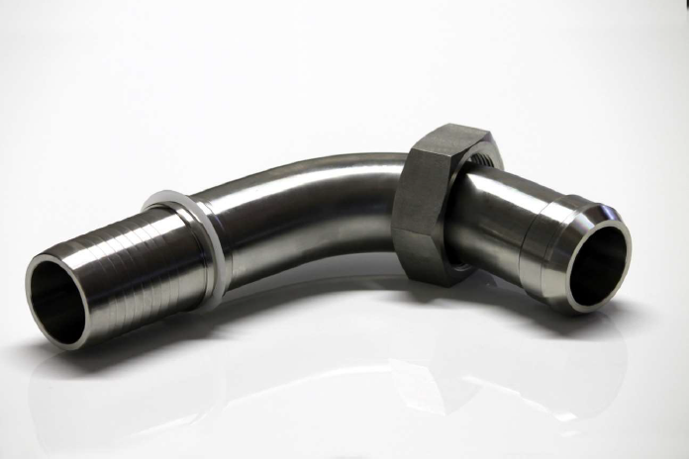
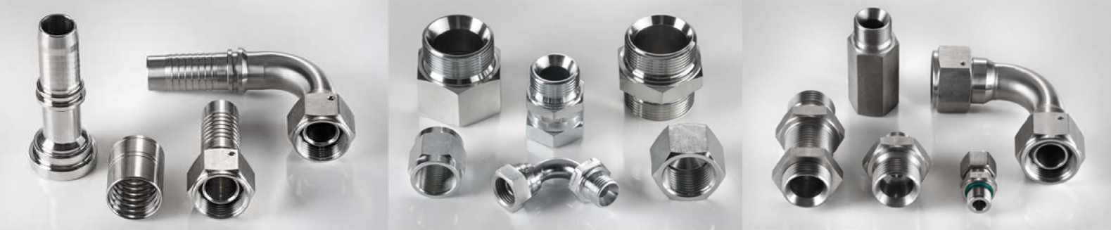
HOSE FITTINGS - ADAPTORS
Available in stock, fittings and adaptors with thread:
    DIN
    JIC
    ORFS
    BSP
in carbon steel and stainless steel, standard and customized.
“One-Piece’’ series on order.

Slide 20
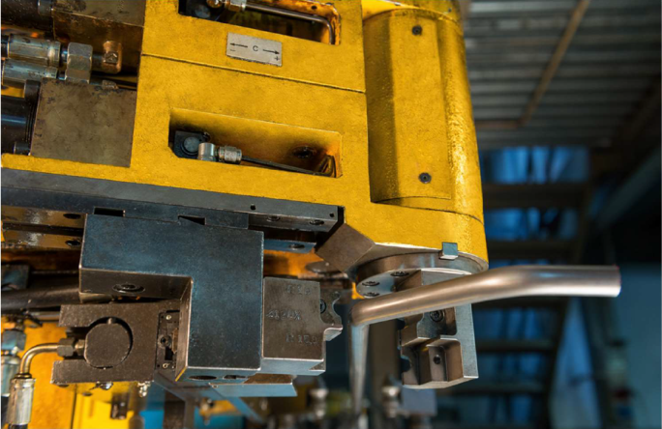
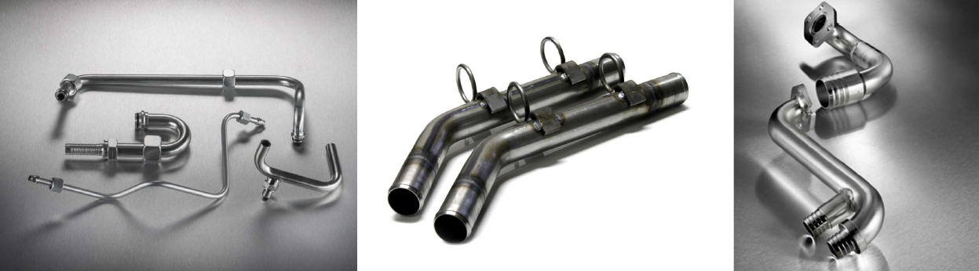
SHAPING PIPE
Pipes for low, medium and high pressures fitted with all kind of hydraulic fittings:
  DIN
  ORFS
  JIC
Manufacturing of pipes both by welding or pipe deformation

Slide 21
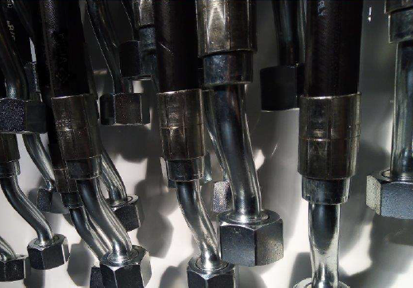
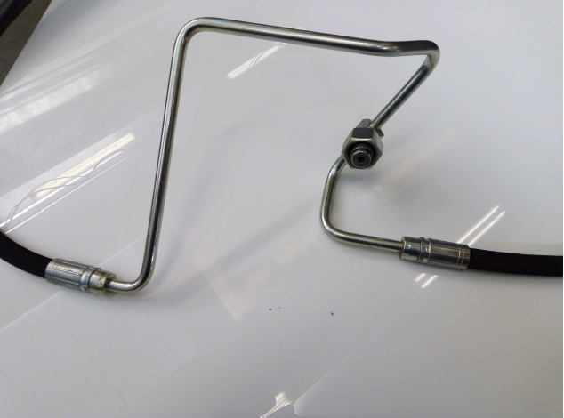
SHAPING PIPES

Slide 22
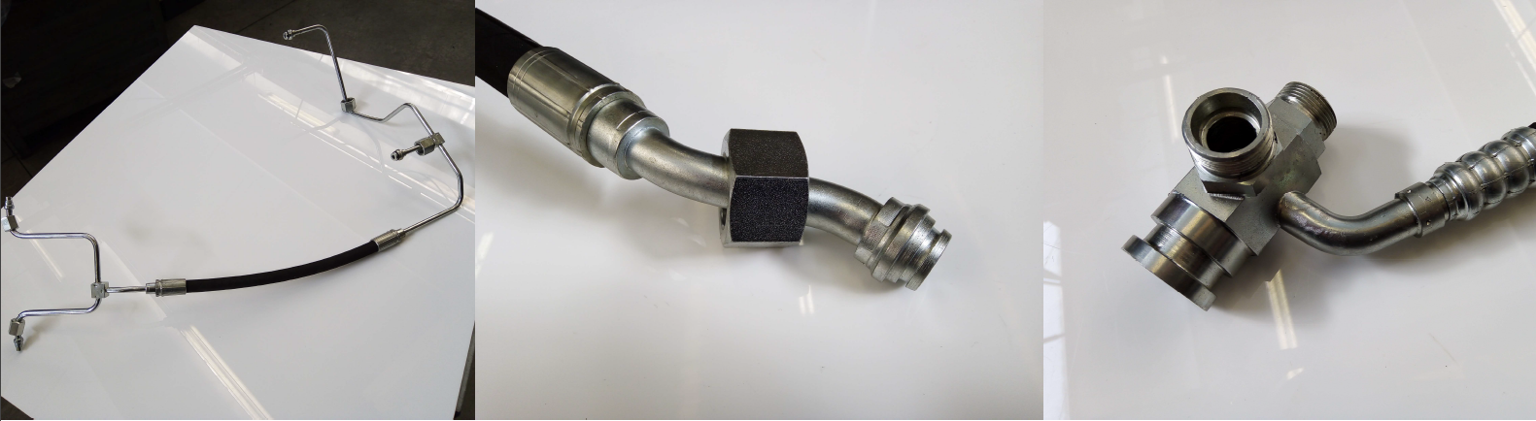
SHAPING PIPES

Slide 23
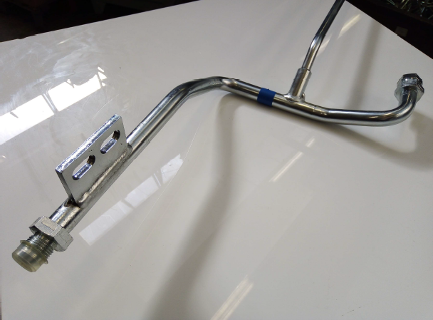
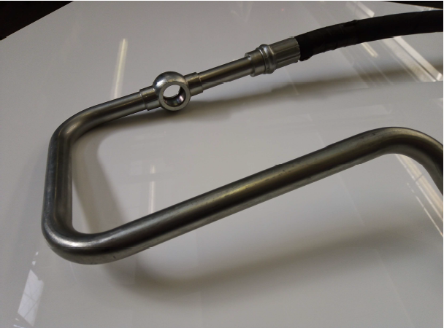
SPECIAL FINISHING

Slide 24
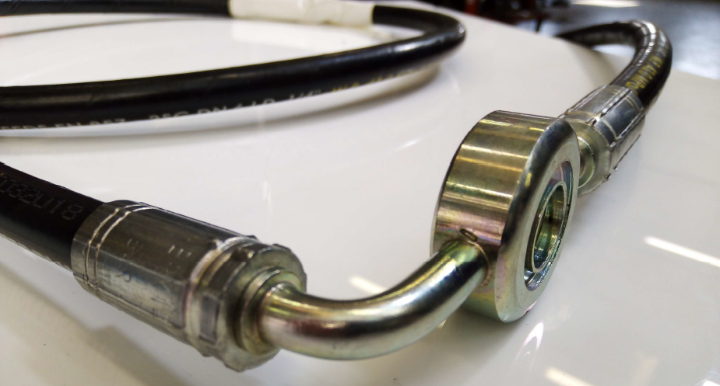
SPECIAL FINISHING

Slide 25
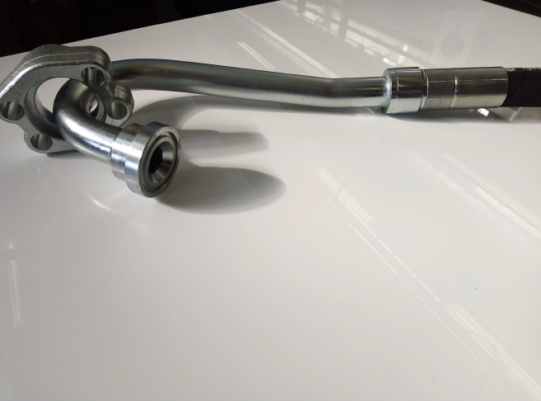
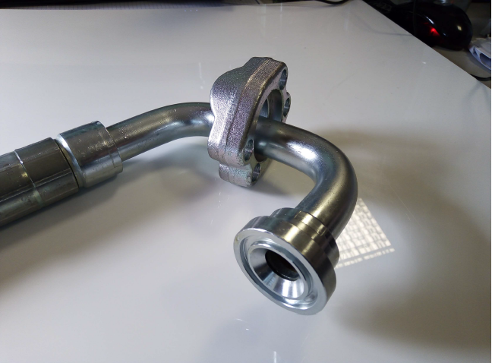
HYDROSTATIC TRASMISSION

Slide 26
WELDING - BENCH TEST
The welding of carbon and stainless steel is carried out by Strong brazing with filler material, Brazing in controlled atmosphere, MIG/TIG electrical welding granting to have complete flow of manufacturing process up to final bench test.

Slide 27
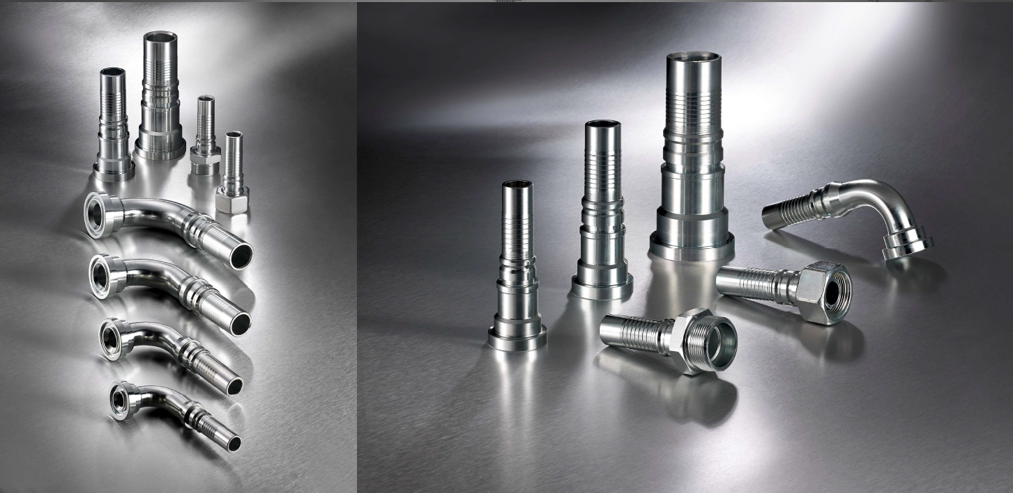
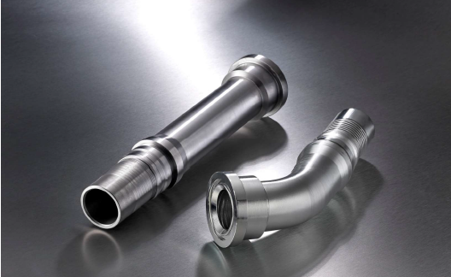
INTERLOCK FITTINGS

Slide 28
THANK YOU FOR YOUR ATTENTION
“A satisfied customer is the best business strategy ~ Michael LeBoeuf
Quality and Innovation Since 1960

